Slide 1

A Performance Analysis on Time-Series-Based
Recommender System
Name: Li Guanlong
Matric number: U1722033H

Slide 2

Motivation
Ignorance of global timeline:
In most of the current researches related to recommender system, the recommendation algorithm proposed is evaluated in a manner that ignores the global timeline of the user-item interactions
Example: leave-one-out, split-by-ratio
Result in poor reproducibility
This project aims to implement an evaluation method that follows the global timeline
global timeline
User A:
User B:
User C:
Mostly Focus on personalized method:
Personalized methods, especially deep-learning based methods has been drawing increasing attention
This project focuses on non-personalized methods, and only cares about the number of interactions received by an item (item popularity)
This project proposes a time-series-based algorithm, this algorithm is compared with other baseline method based on an evaluation method which follows the global timeline

Slide 3
Algorithm Implementation Details

Slide 4
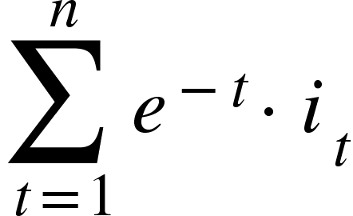
Algorithms Experimented
Baseline algorithms:
All algorithms discussed in this project are top-N recommenders that first predict the item popularity for each item on a specific day and then make recommendations based on the ranking of the predicted popularity of all the items on that day
MostPop: predicts item’s popularity on day t₀ based on the total number of interactions the item received from day 1 until day t₀ – 1 in the training set
RecentPop: Uses a parameter Δt, such that the predicted popularity for an item on day t₀ is based on the total number of interactions the item received during time period [t₀ - Δt, t₀ - 1] in the training set
DecayPop: Uses a decay parameter on top of RecentPop. If the item is interacted for i₁, i₂, i₃ … i_{n} times respectively, where i₁ is corresponding to t₀ – 1 (the most recent day) and i_{n} is corresponding to t₀ - Δt (the least recent day). Then the predicted popularity of the item is calculated by:
 | Day 1 | Day 2 | Day 3 | Day 4 | Day 5 | Day 6
Item A | 10 | 10 | 3 | 2 | 1 | ?
Item B | 0 | 2 | 6 | 5 | 4 | ?
Item C | 1 | 1 | 3 | 5 | 6 | ?
Proposed algorithm:
Time-series-based Algorithm

Slide 5
Time-series-based Algorithm
Preselection:
Obtain possible candidate items: the items that have been rated at least once during [t₀ - Δt, t₀ - 1]
Obtain preselected items: setting a threshold th, such that only the items which had been rated for at least “th” times in any of the day during [t₀ - Δt, t₀ - 1] will be considered
Further processing:
Make prediction: for each individual item in preselected items, its own time series during [t₀ - Δt, t₀ - 1] is used to train a regression model, which is then used to predict the item’s popularity on day t₀
Make recommendation: based on the ranking of predicted popularity, a non-personalised top-N recommendation is performed to all users on day t₀

Slide 6


Evaluation
training set t₀ “future data”
training set “future data”
training set t₀ “future data”
training set t₀
training set t₀ “future data”
evaluation set
evaluation set
evaluation set
evaluation set
Use MovieLens 25M dataset, only the data between November 01, 2009 and October 31, 2019
Initially, training set and “future data” each contains 5 years
Start from the first day of the last 5 years, all the way until the last day of the last 5 years
For each evaluation set, obtain the daily R-precision, yearly average of such daily R-precision is used for comparison
MostPop uses data from [t_{ini}, t₀ – 1] for training
RecentPop, DecayPop and time-series-based algorithm use data from [t₀ - Δt, t₀ - 1] for training
training set “future data”

Slide 7
Algorithm Parameter Selection

Slide 8
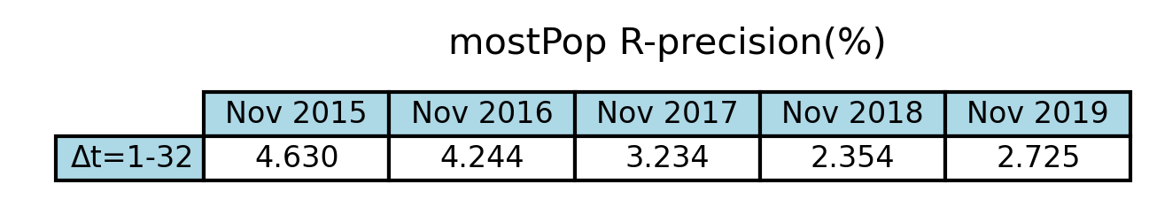
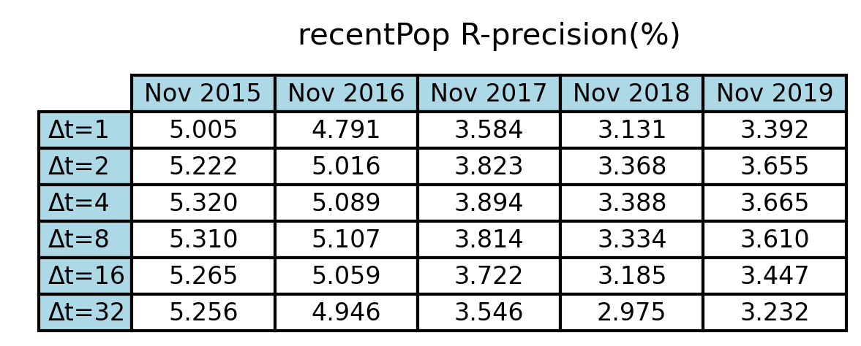

Experiment: Parameter Selection
Parameter selection for baseline algorithms:
There is no parameter for MostPop
For RecentPop and DecayPop, Δt = 1, 2, 4, 8, 16, 32 days are experimented
Experiment result:
Optimal Δt for RecentPop is 4 days
Optimal Δt for DecayPop is 8 days
RecentPop with Δt = 4 days achieves the highest R-precision

Slide 9
Experiment: Parameter Selection
Parameter selection for time-series-based algorithm
Select threshold th: different th values of 0, 2, 4, 6, 8, 10 are experimented
Select Δt: different Δt values of 4, 8, 16, 32, 64 are experimented
Select regression model: linear regression, SVR with linear kernel, SVR with RBF kernel, ridge regression, Huber regression are experimented

Slide 10
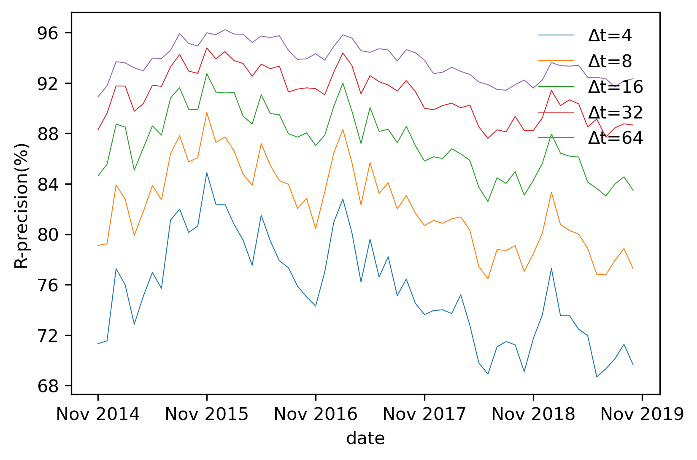
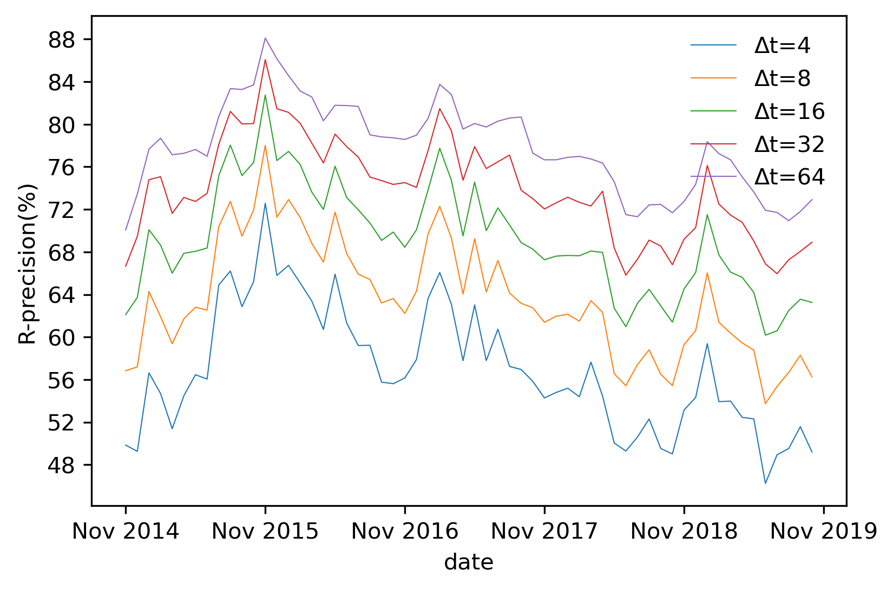
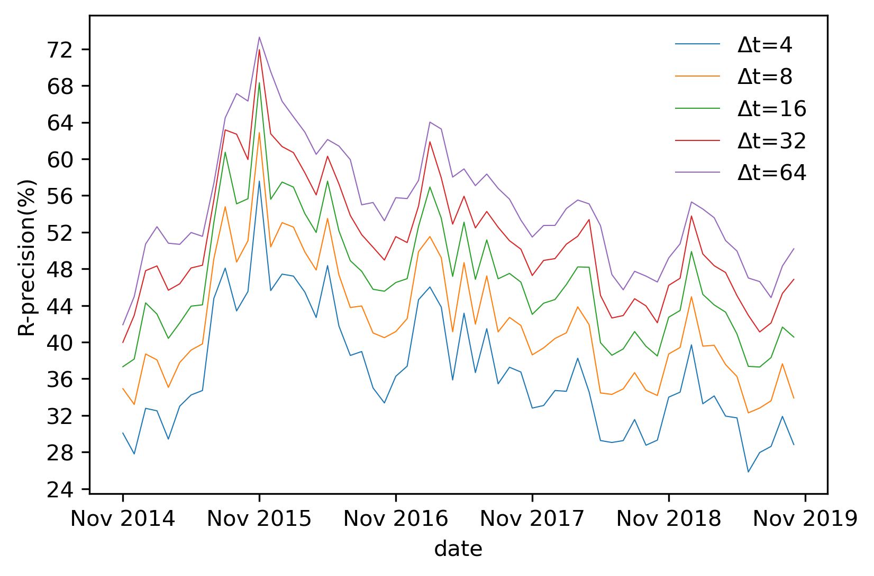
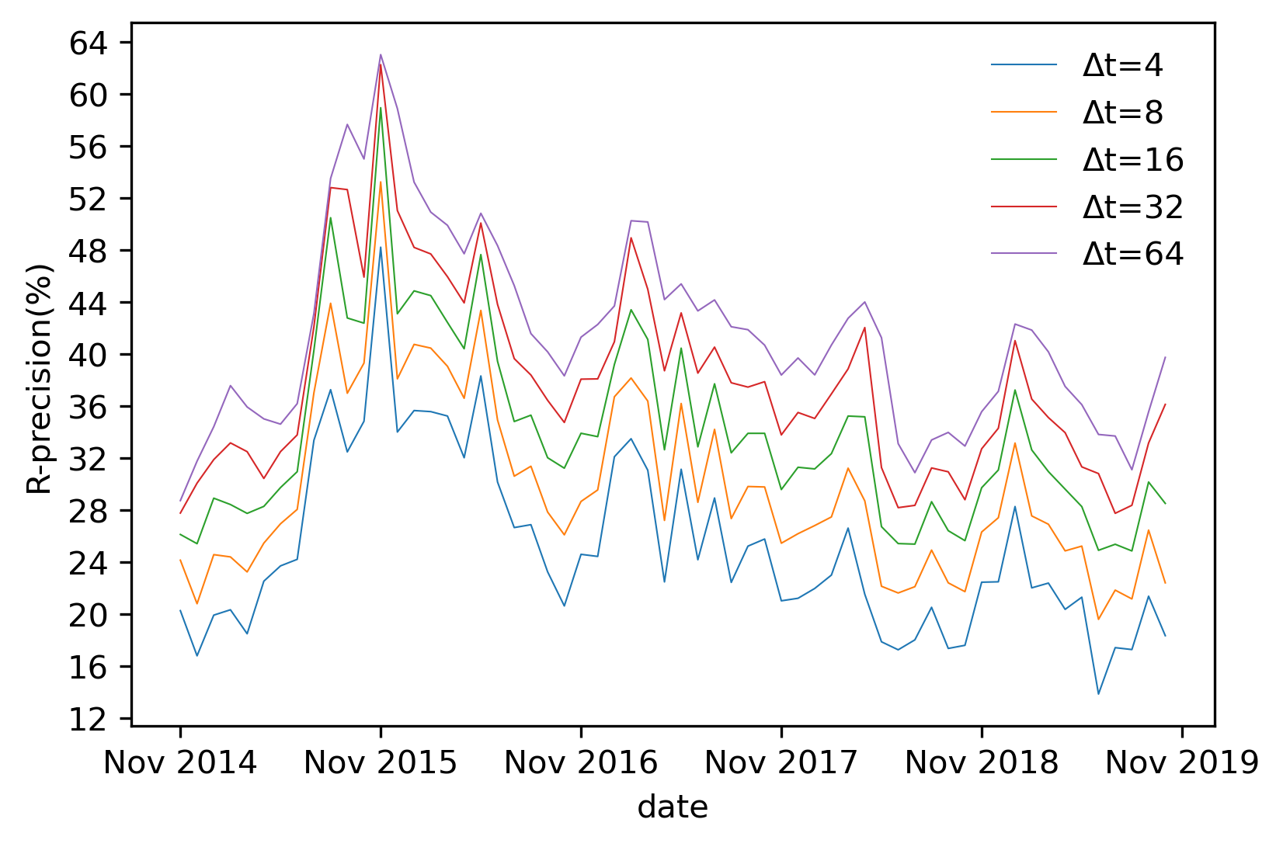
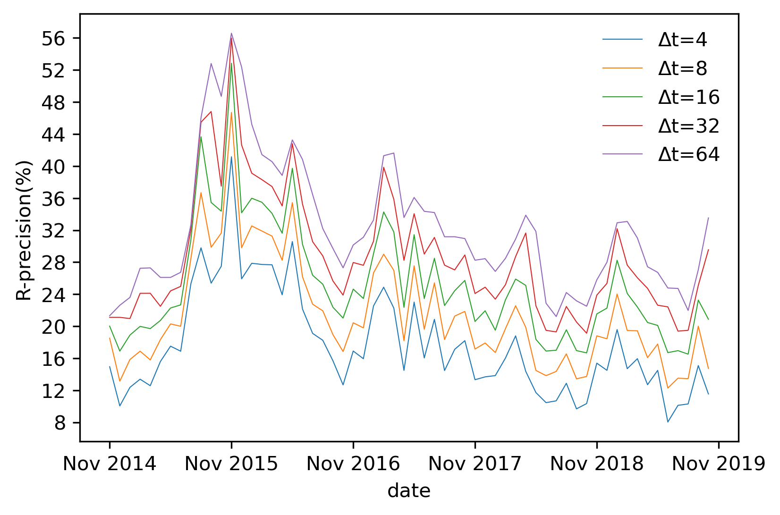
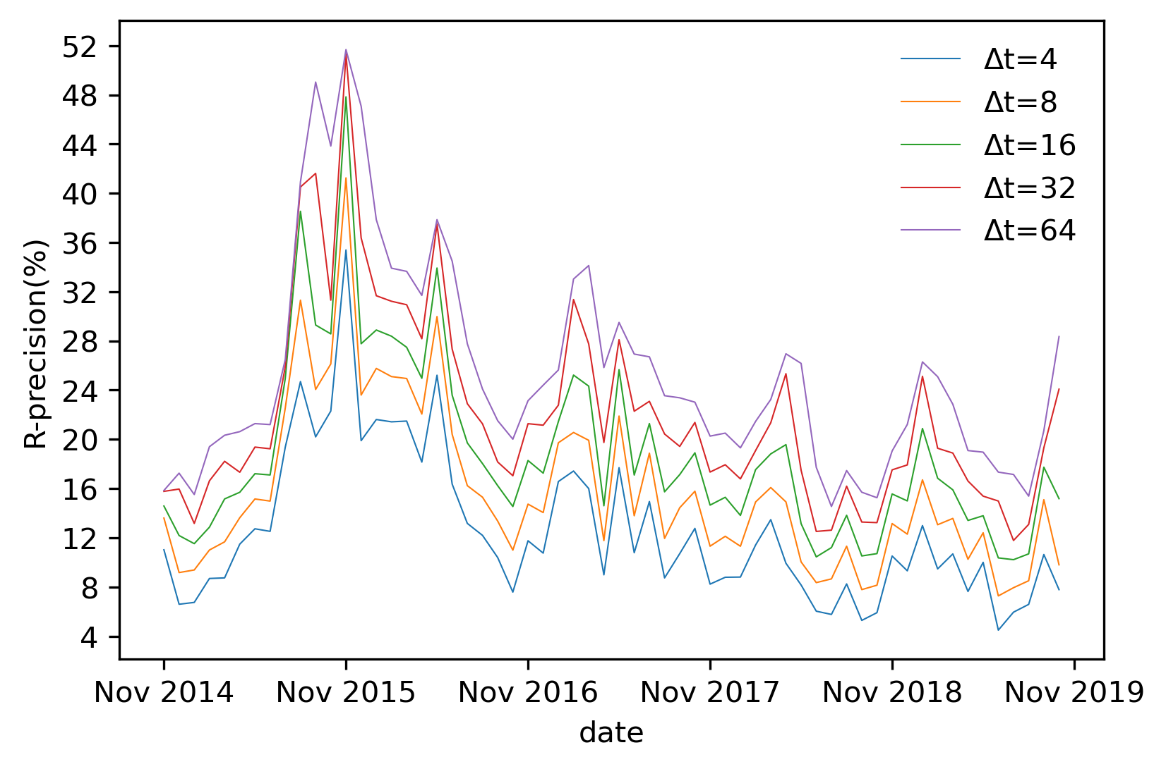
Experiment: Parameter Selection
Select threshold th:
th = 2, 4, 6, 8 are chosen to be experimented later
Ideal R-precision for th = 0 Ideal R-precision for th = 2 Ideal R-precision for th = 4
Ideal R-precision for th = 6 Ideal R-precision for th = 8 Ideal R-precision for th = 10

Slide 11
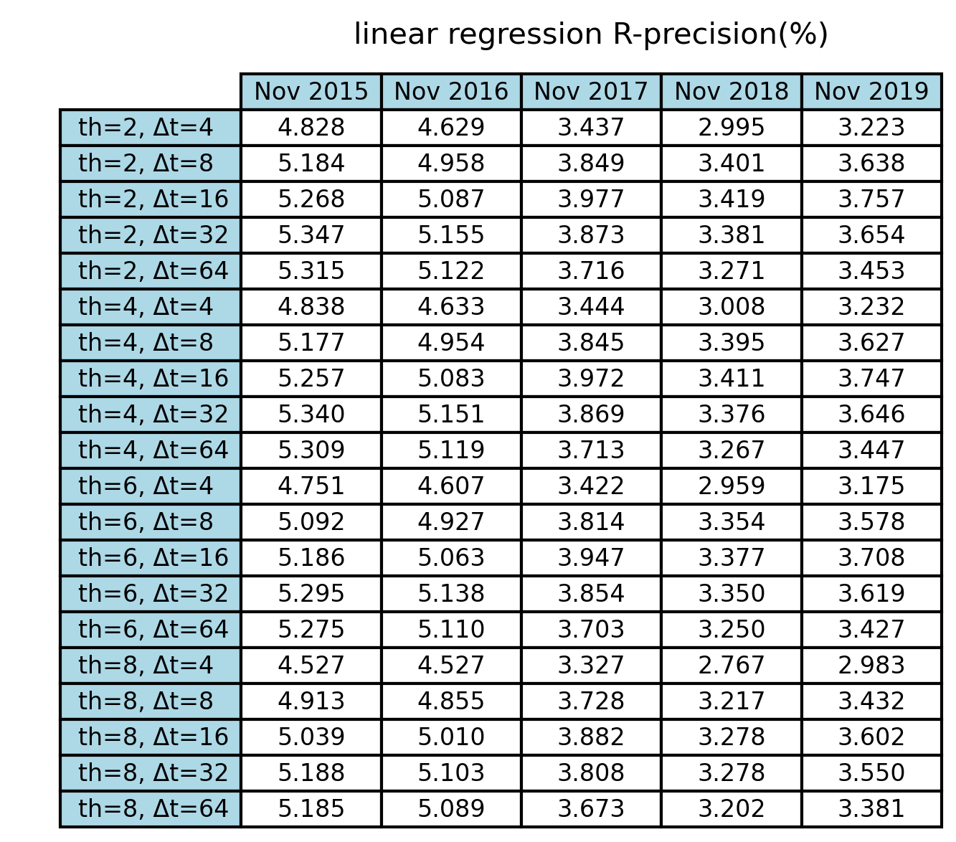
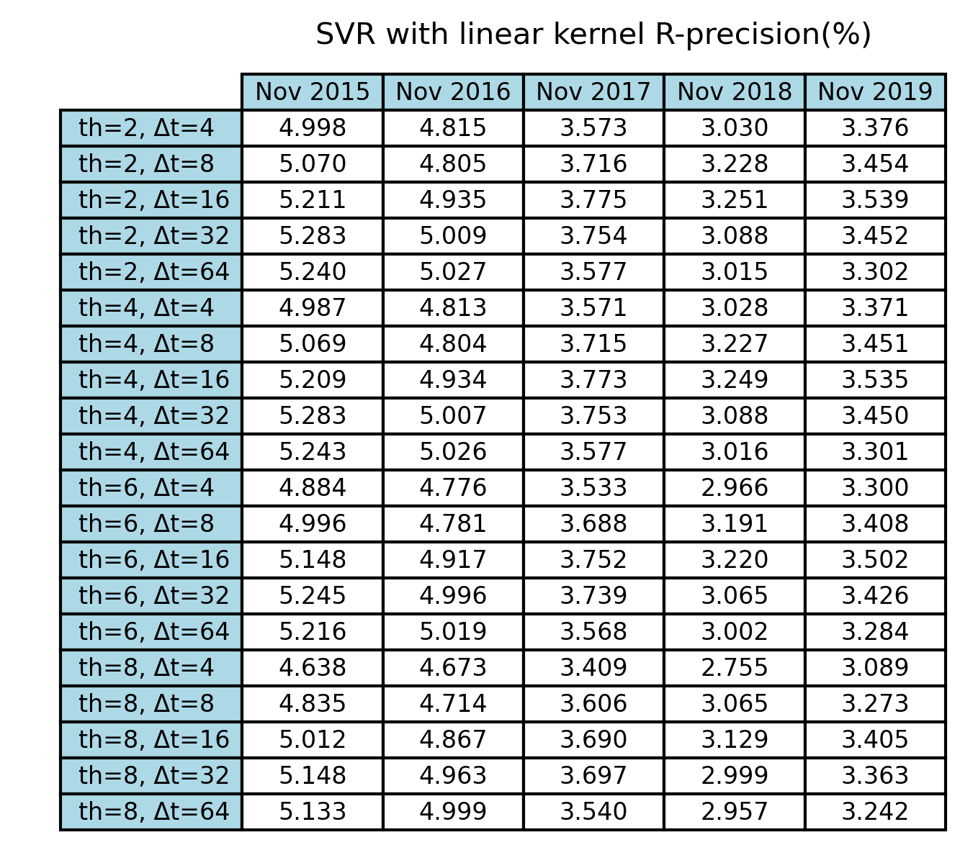
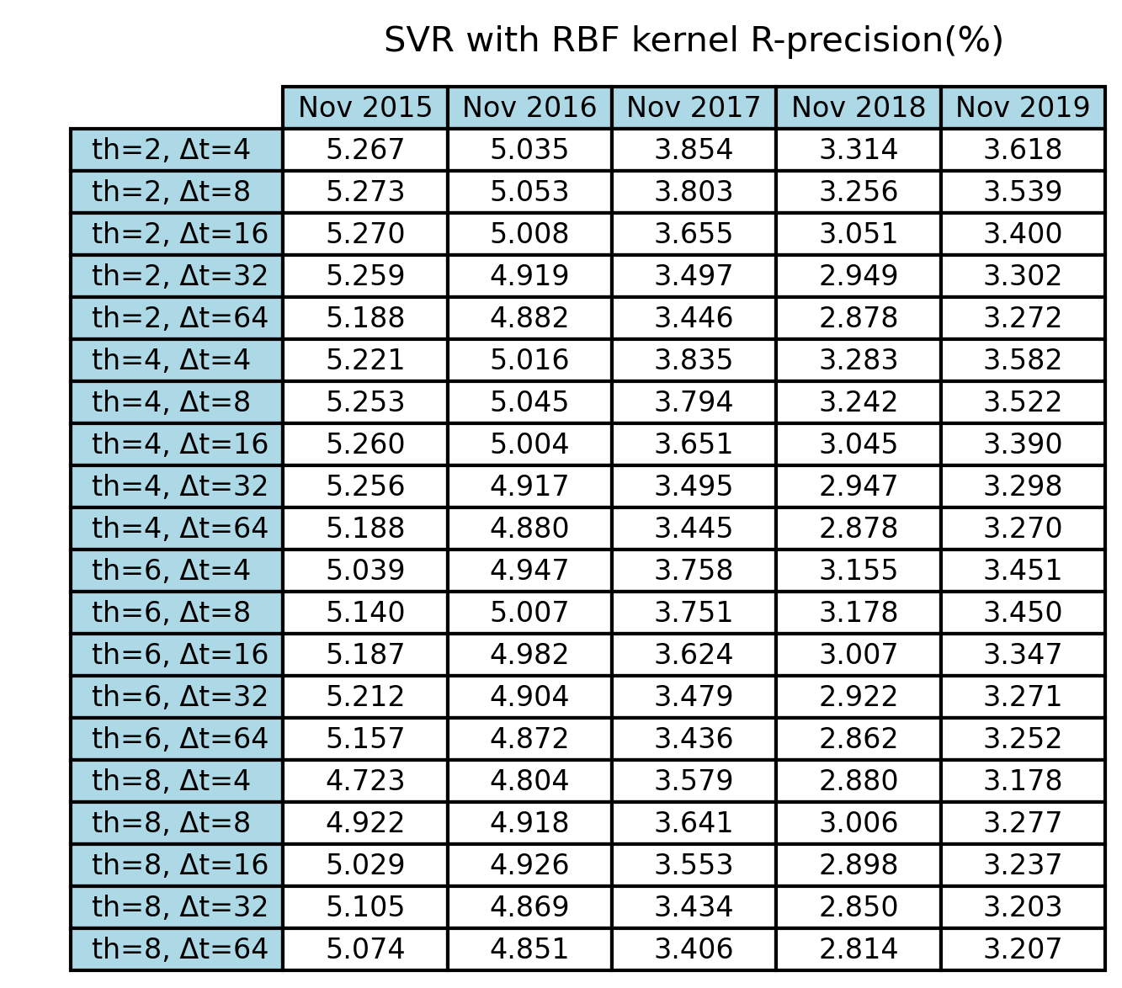
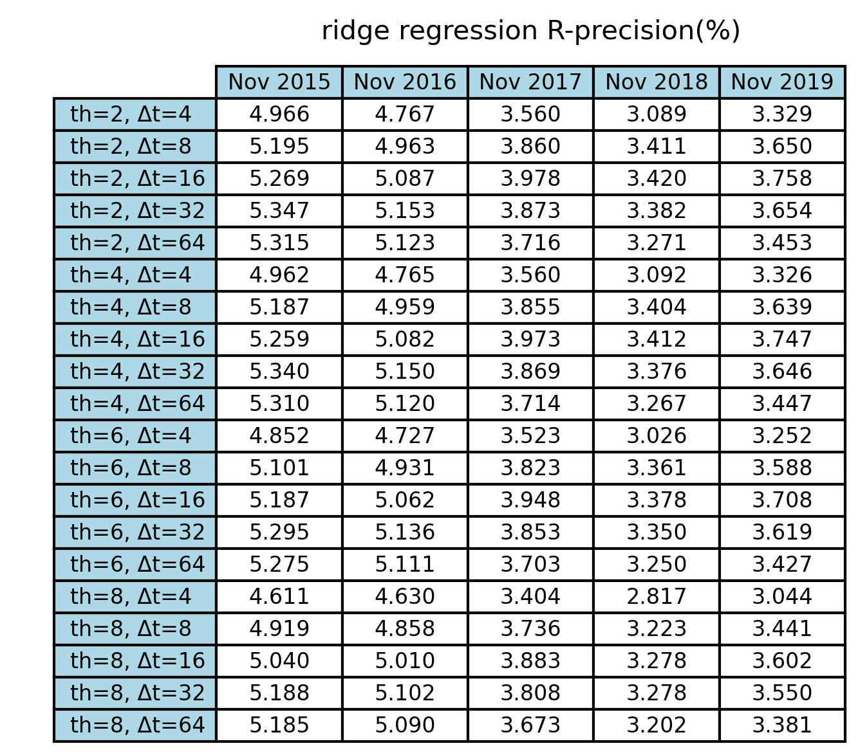
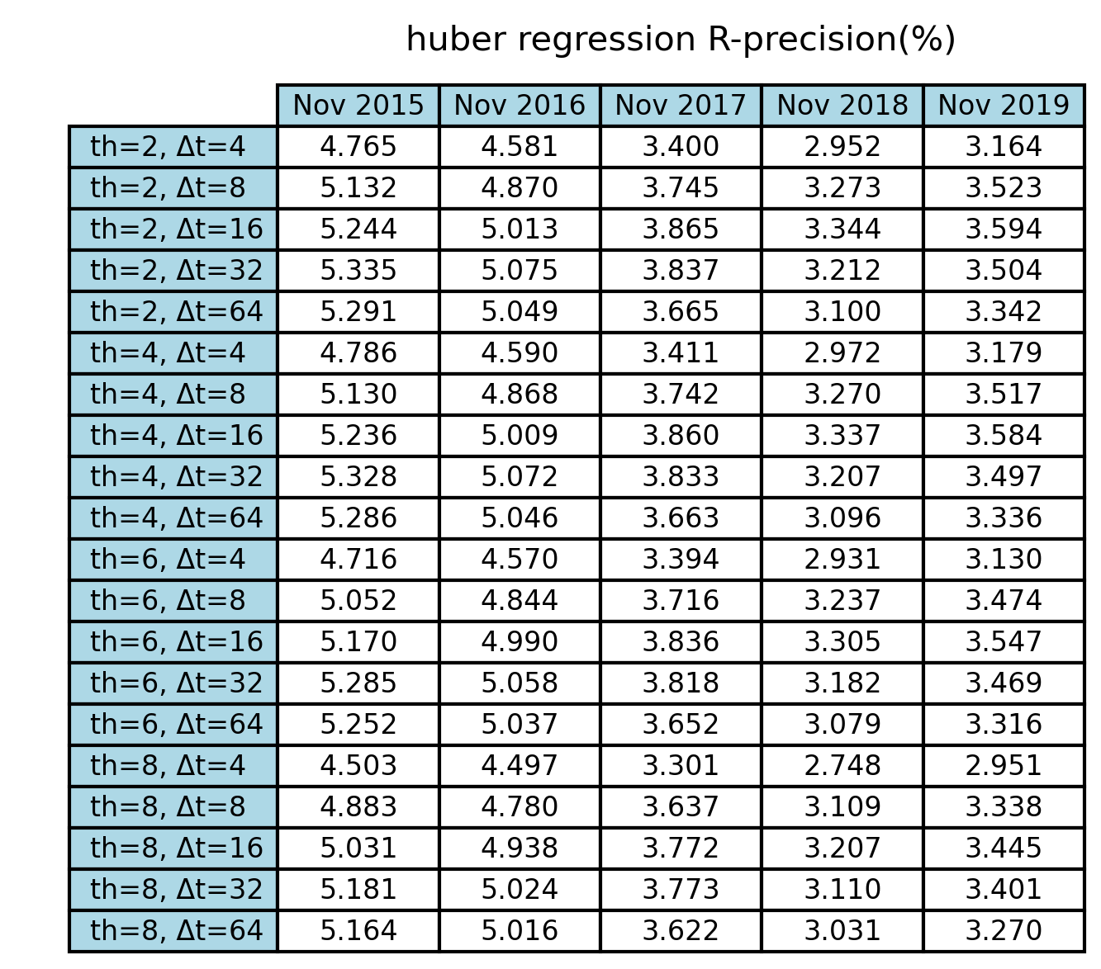
Experiment: Parameter Selection
Select regression model, th, and Δt:

Slide 12
Algorithm Comparison

Slide 13
Experiment: Comparison
Ridge regression with th = 2, Δt = 16 days vs RecentPop with Δt = 4 days
Time-series-based method outperforms the baseline methods

Slide 14
Data Smoothing

Slide 15
Experiment: Data Smoothing
Data smoothing for the time-series-based method is performed by:
Change the unit of Δt from day to week, such that the movie’s time series during [t₀ – 7*Δt, t₀ - 1] is used when making prediction for day t₀
For the movie’s time series during [t₀ – 7*Δt, t₀ - 1], calculate an average value for each 7-day time interval
Obtain an array of such average values, such that the array has a length of Δt
Change the preselection criterion to that at least one value in the array should be larger or equal to th
Train each of the five regression models using the array of average values
Parameter selection for time-series-based algorithm with data smoothing
Select threshold th: different th values of 0, 1, 2, 4, 6, 8 are experimented
Select Δt: different Δt values of 4, 8, 16, 32, 64 are experimented
Select regression model: the same five regression models

Slide 16
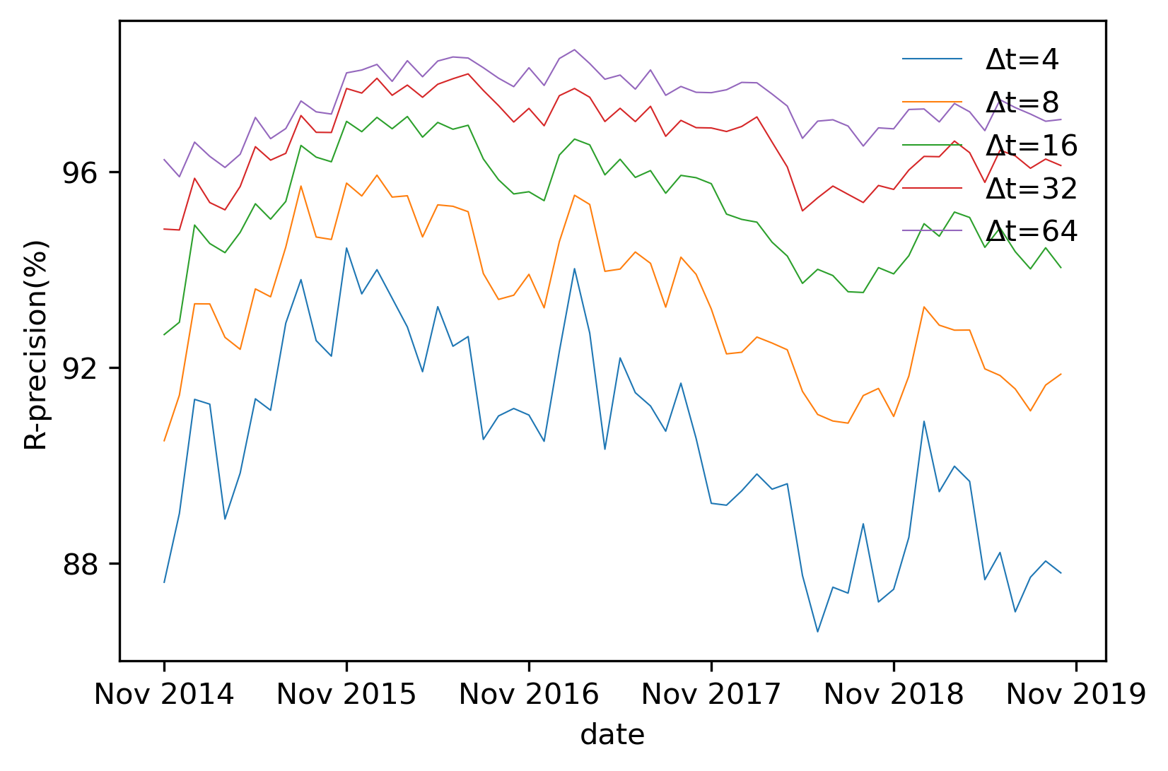
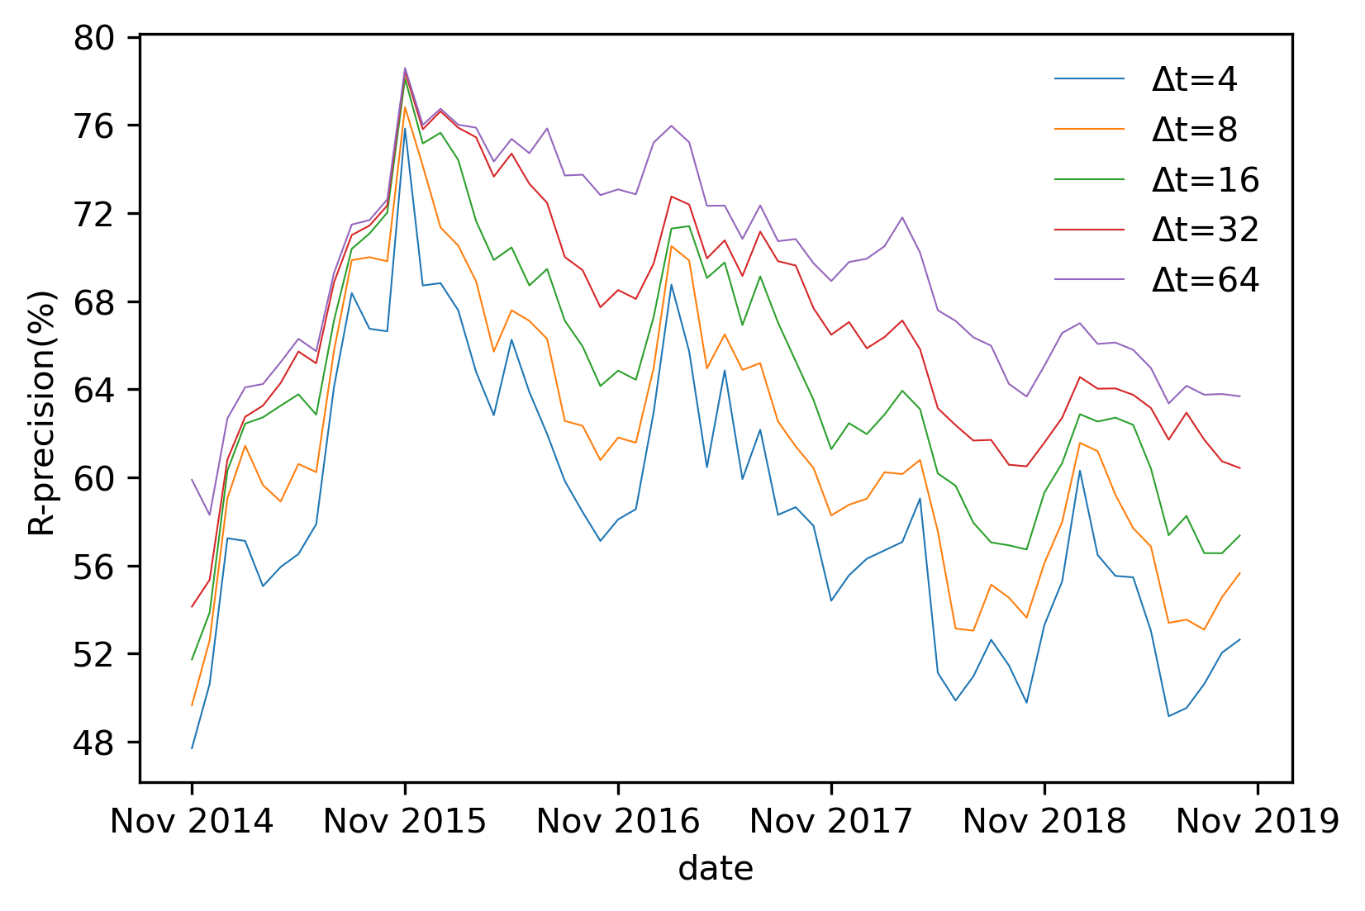
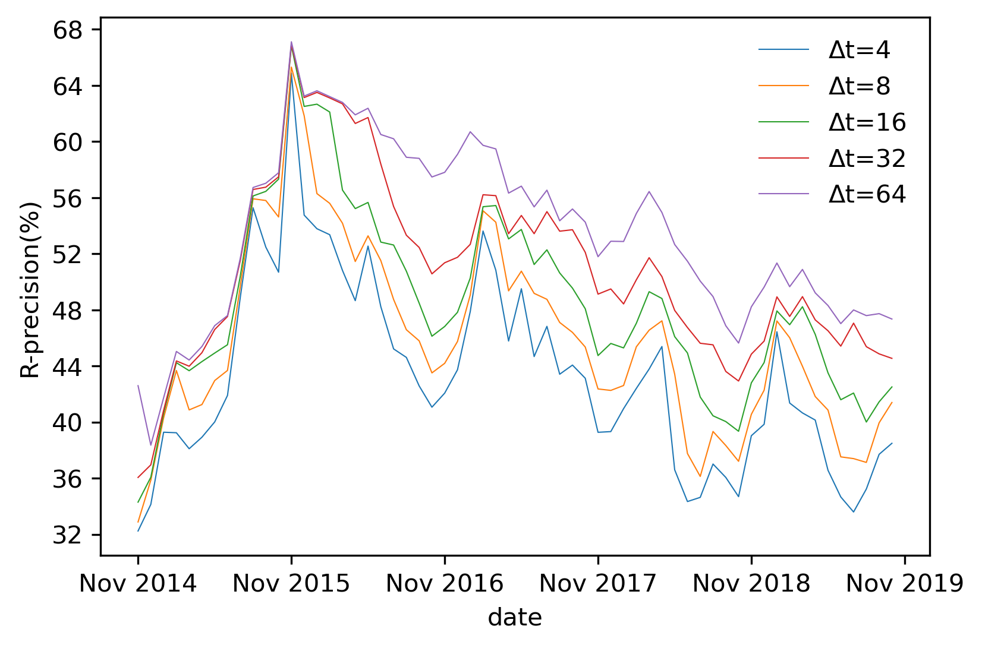
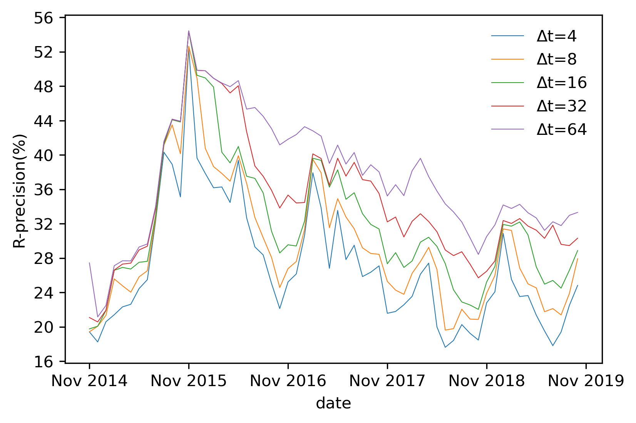
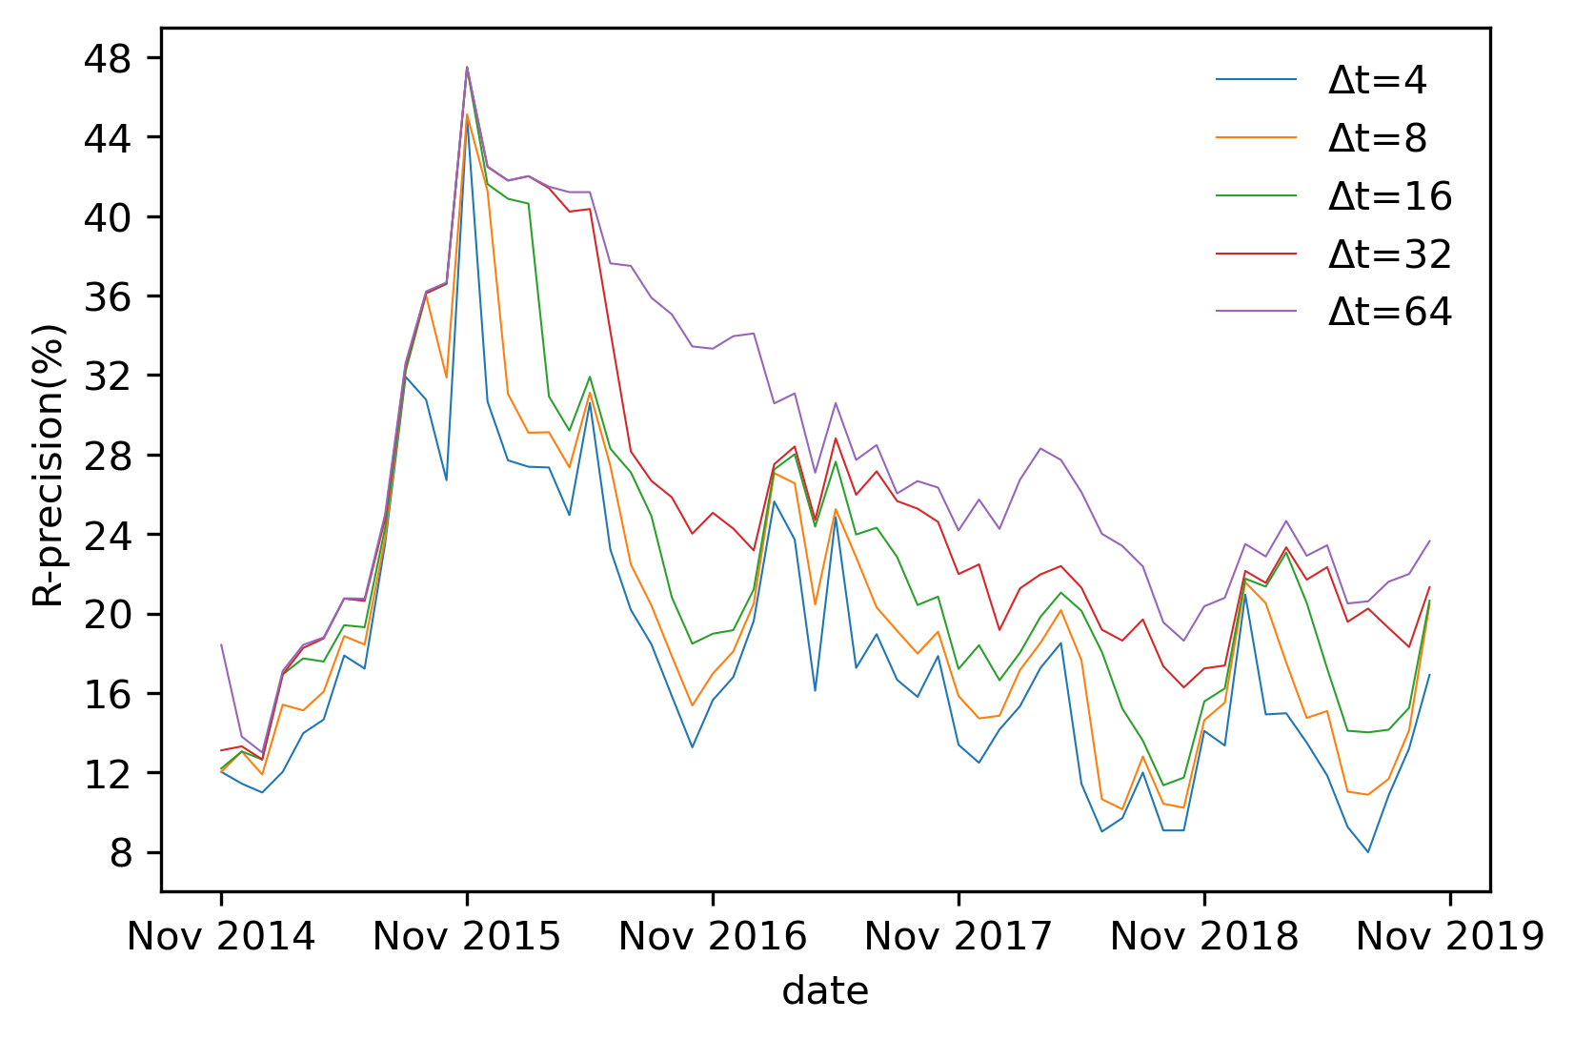
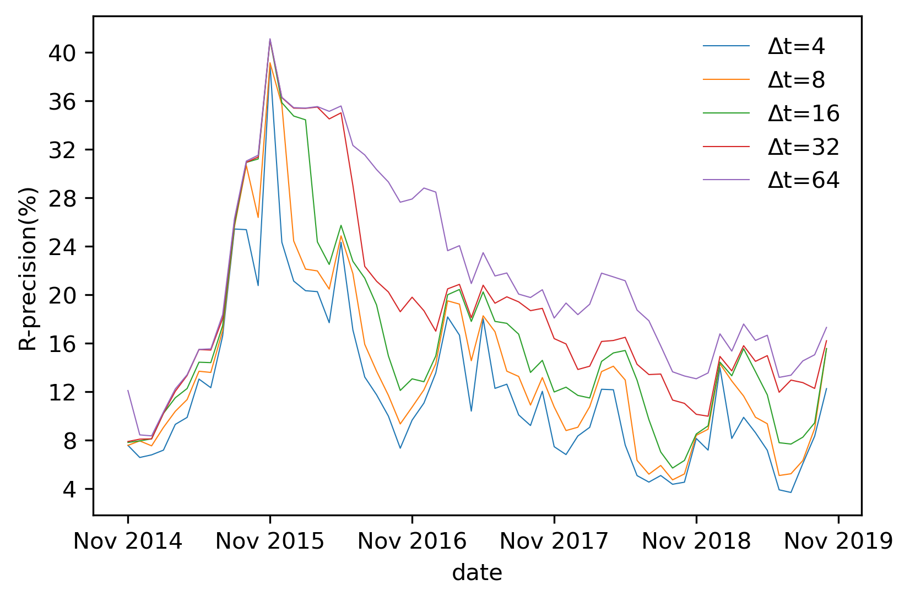
Experiment: Data Smoothing
Select threshold th:
th = 1, 2, 4, 6 are chosen to be experimented later
Ideal R-precision for th = 0 Ideal R-precision for th = 1 Ideal R-precision for th = 2
Ideal R-precision for th = 4 Ideal R-precision for th = 6 Ideal R-precision for th = 8

Slide 17
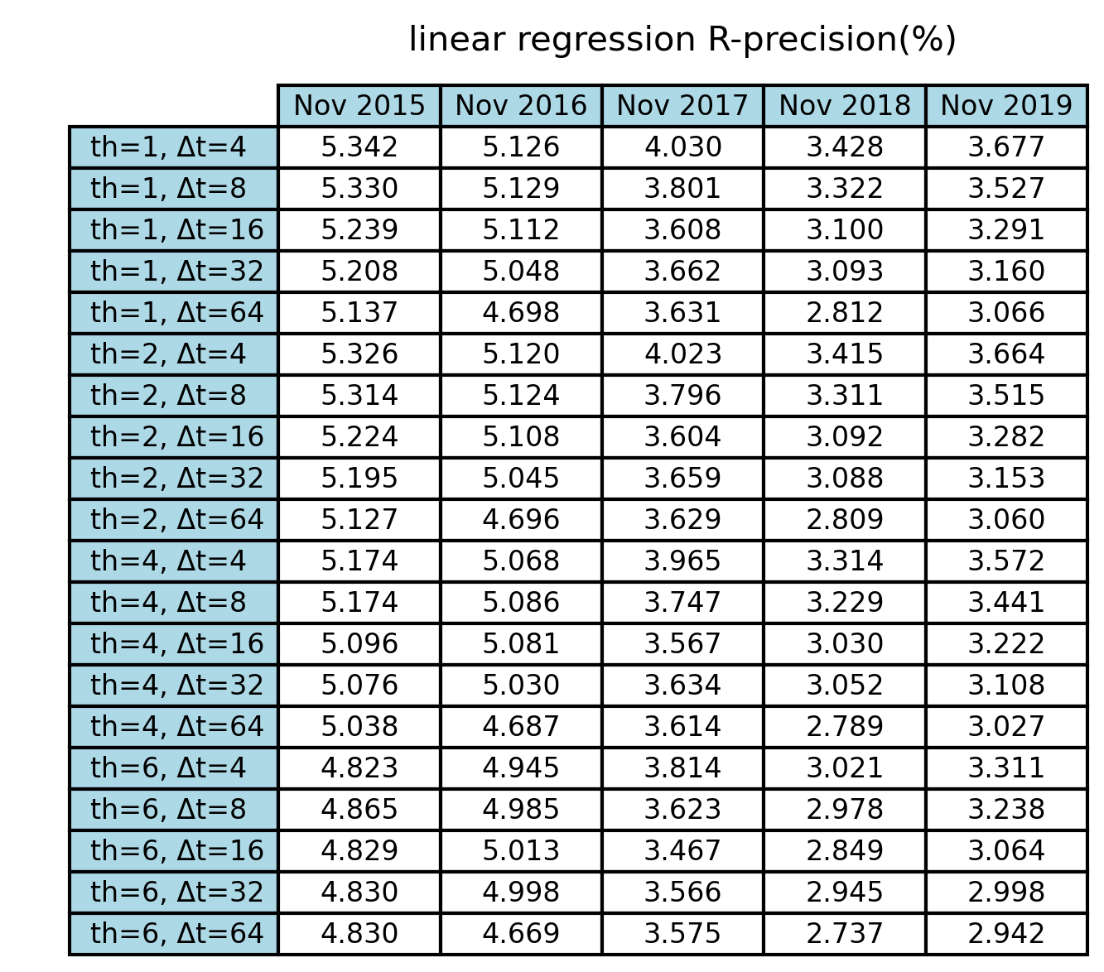


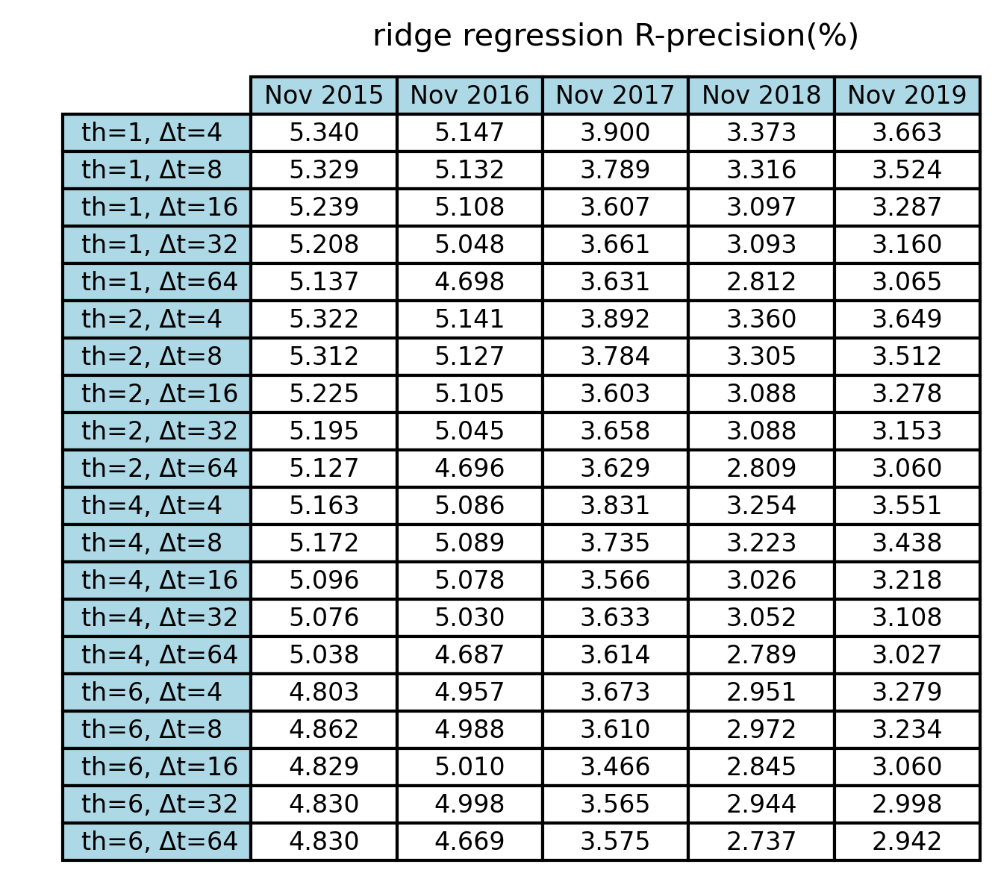

Experiment: Data Smoothing
Select regression model, th, and Δt:

Slide 18
Experiment: Data Smoothing
Without smoothing: With smoothing: Baseline method: (Ridge regression with th = 2, Δt = 16 days) (huber regression with th = 1, Δt = 4 weeks) (RecentPop with Δt = 4 days)
Data smoothing performed is not improving the performance
But still outperforms the baseline methods

Slide 19
Time Series Clustering

Slide 20
Experiment: Clustering
Clustering is performed by:
(i) For each movie presented between November 01, 2009 and October 31, 2019 in the MovieLens 25M dataset, its 1-year (364 days) time series starting from its release date is obtained
(ii) Only keep the movies that received no less than 100 ratings during the 1-year time series (among all 58594 movies, only 2746 of them fit this criterion)
(iii) Perform a data smoothing by taking average value in every 7-day time interval, so the length of each time series becomes 364 / 7 = 52
(iv) Perform clustering based on cosine similarity between time series data
(v) Utilize HDBSCAN algorithm for clustering

Slide 21
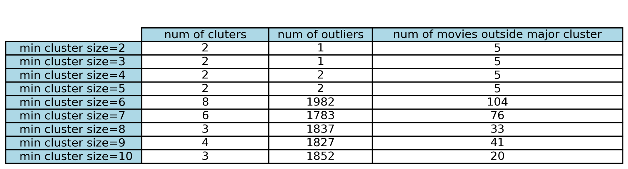
Experiment: Clustering
Different min cluster size values of 2, 3, 4, 5, 6, 7, 8, 9, 10 are experimented
Four criteria for selecting the proper min cluster size:
Number of cluster formed
Number of outliers
Number of movies that are outside of major cluster
The shape of actual formed clusters

Slide 22
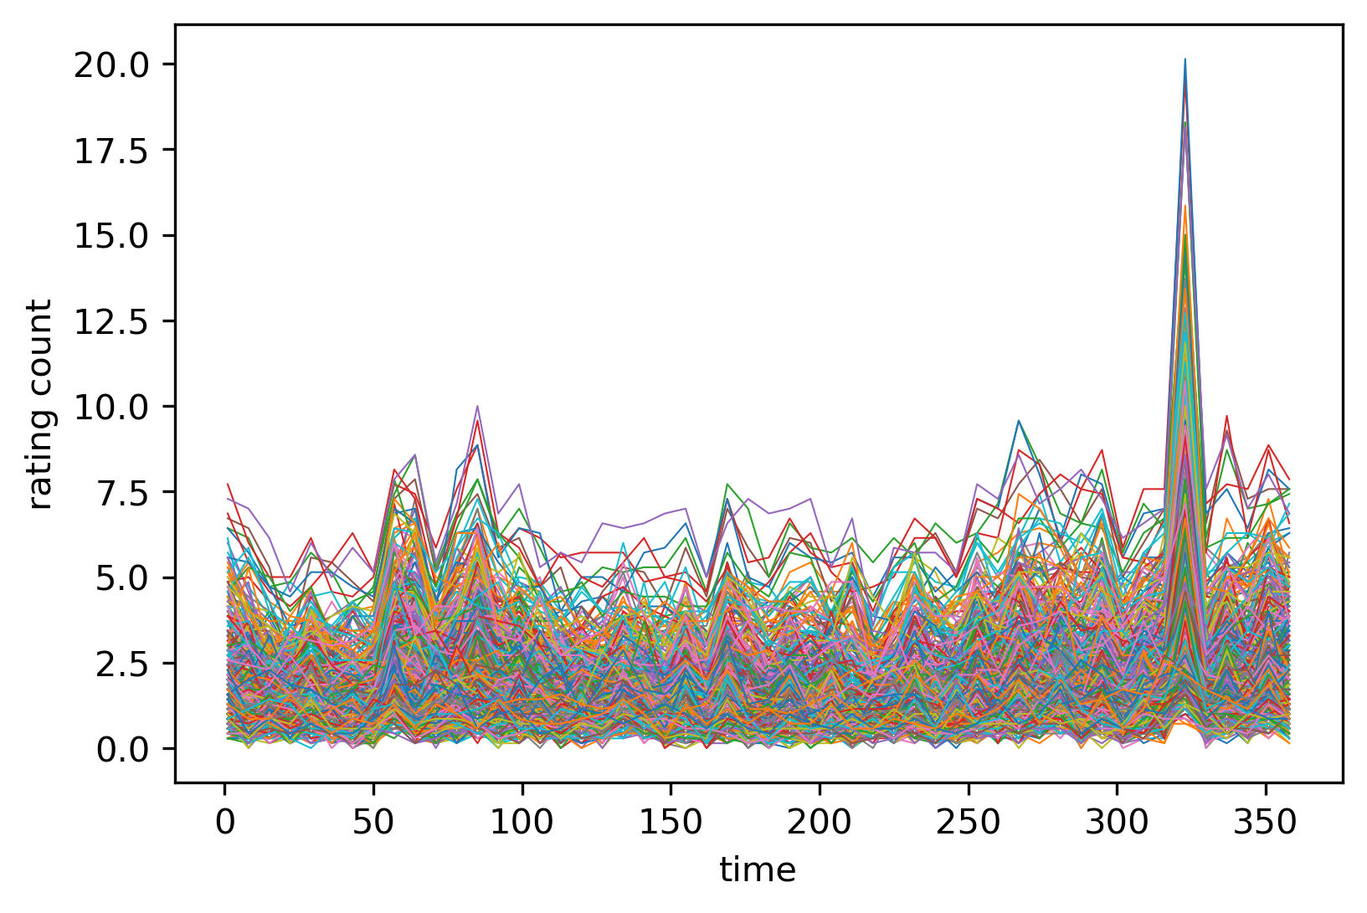
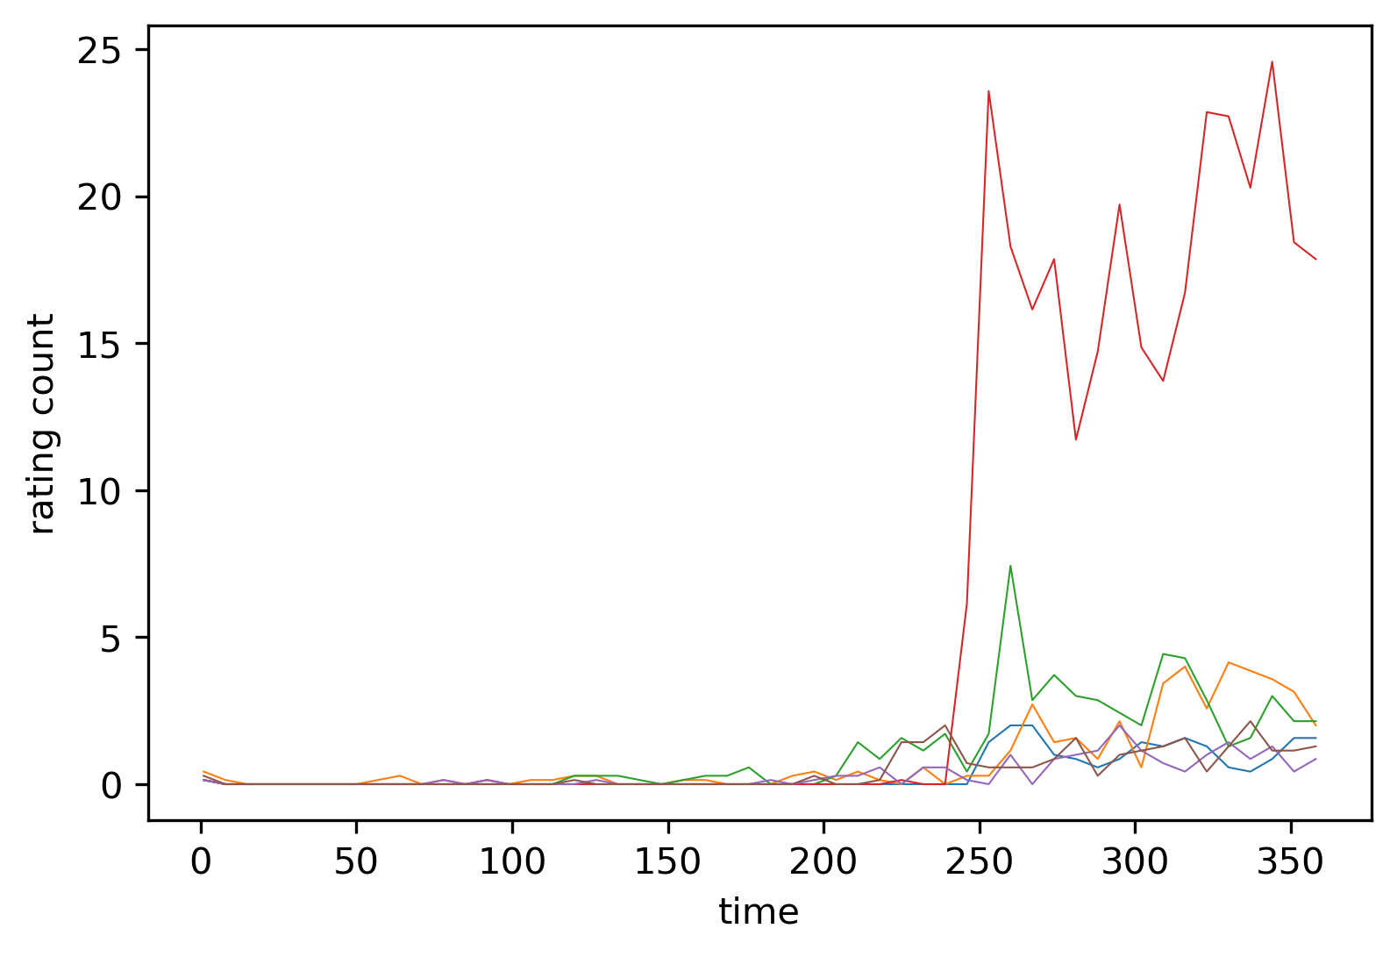
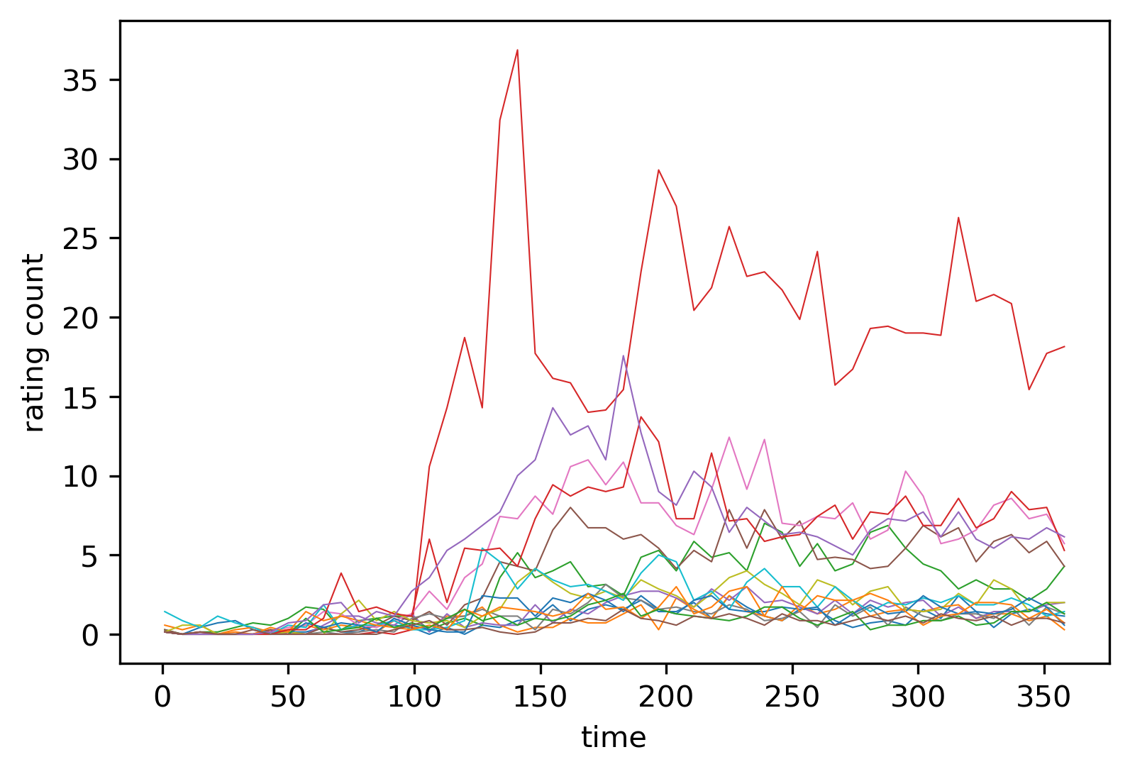
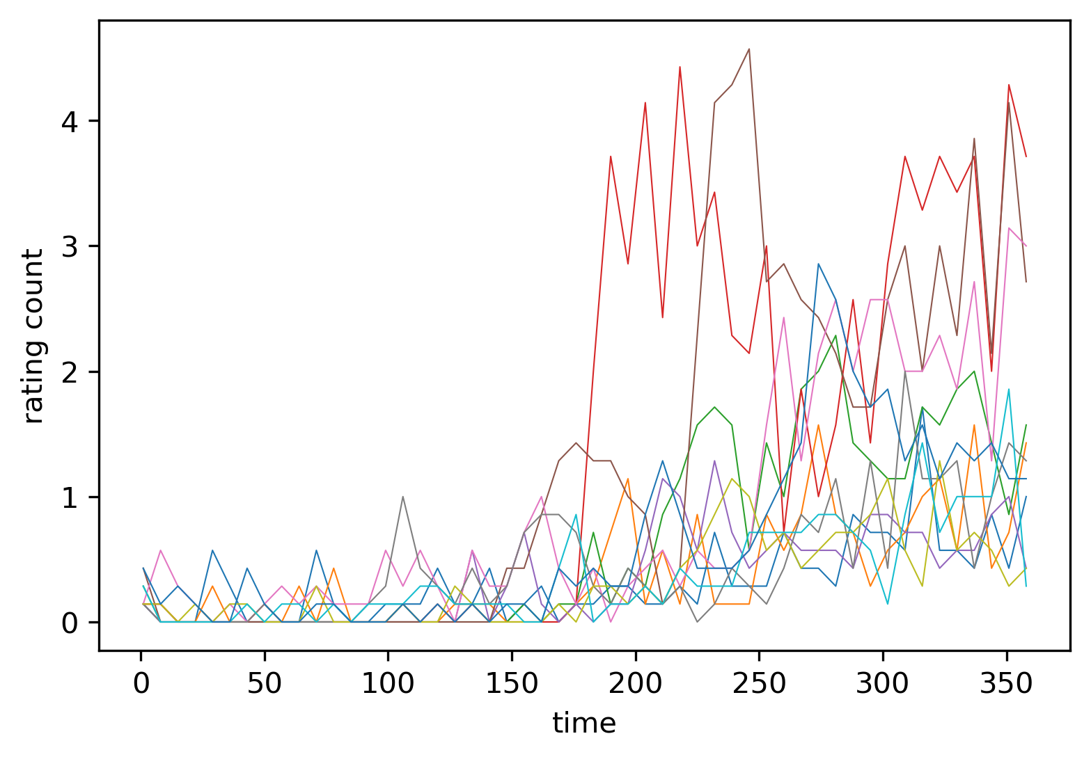
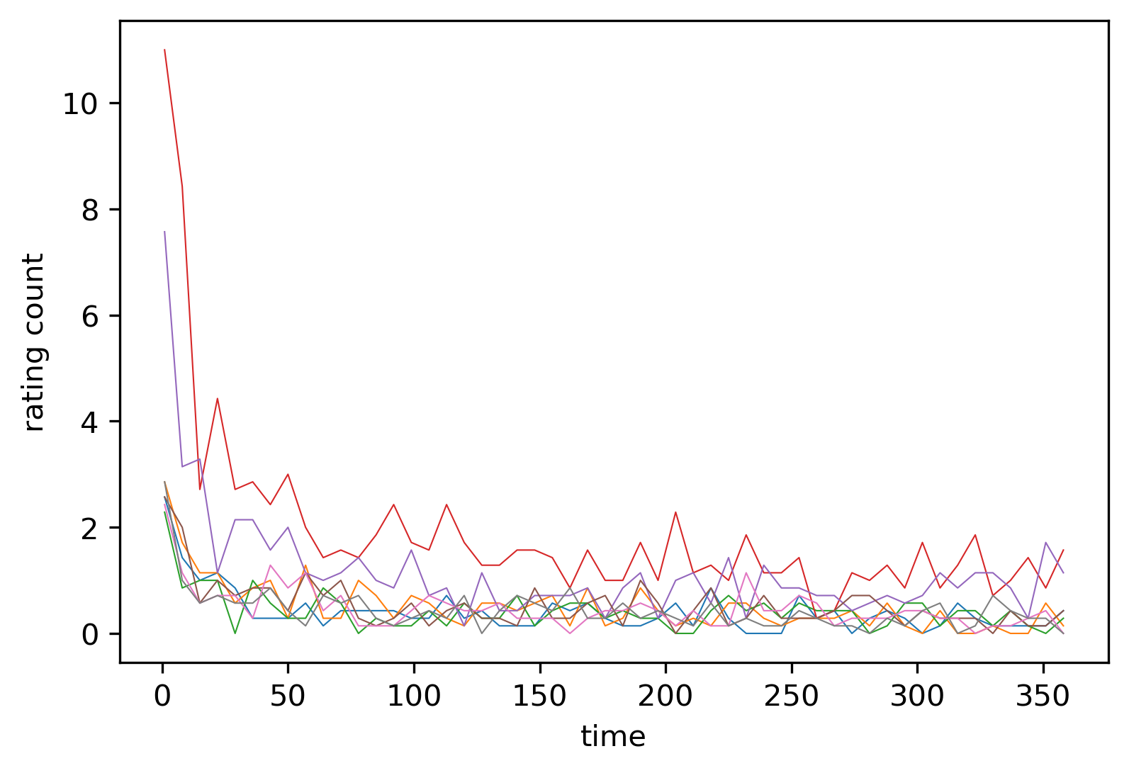
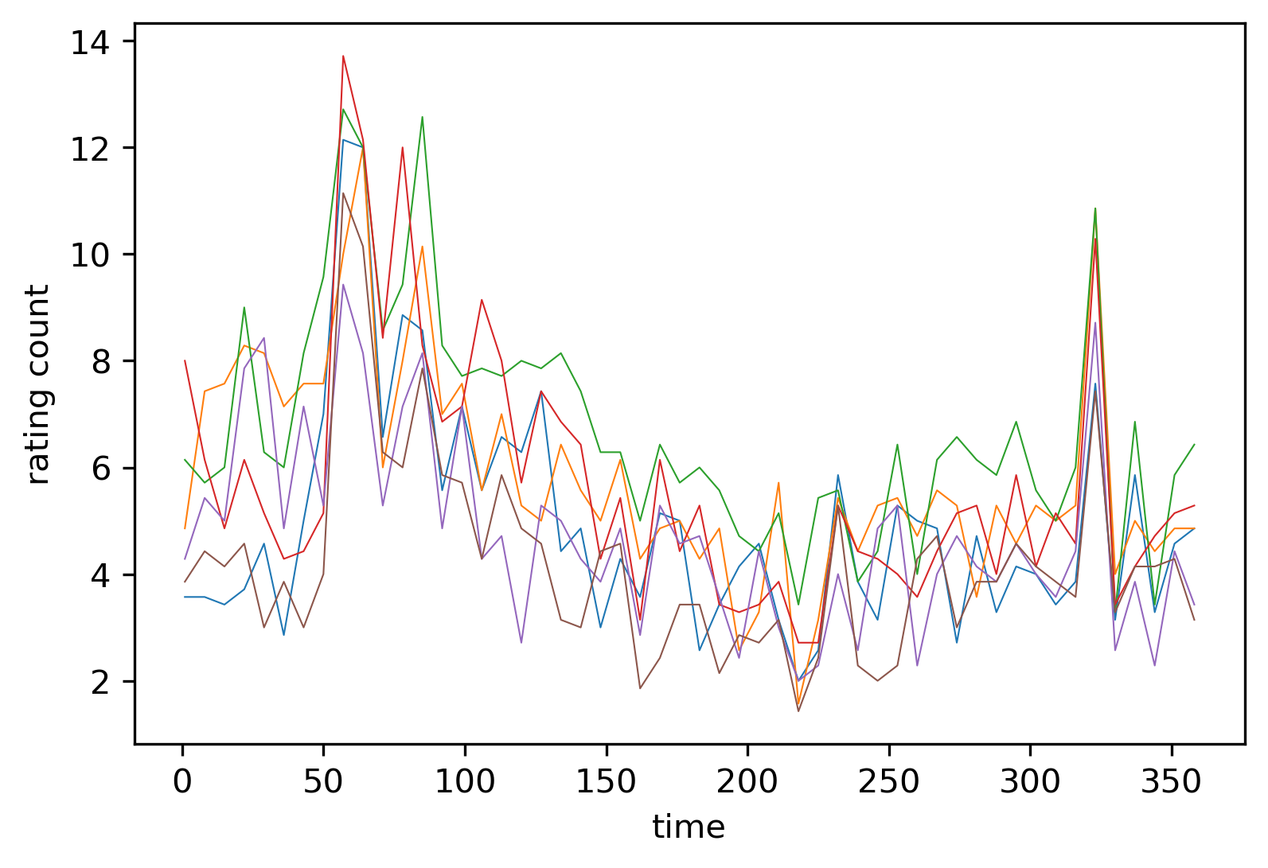
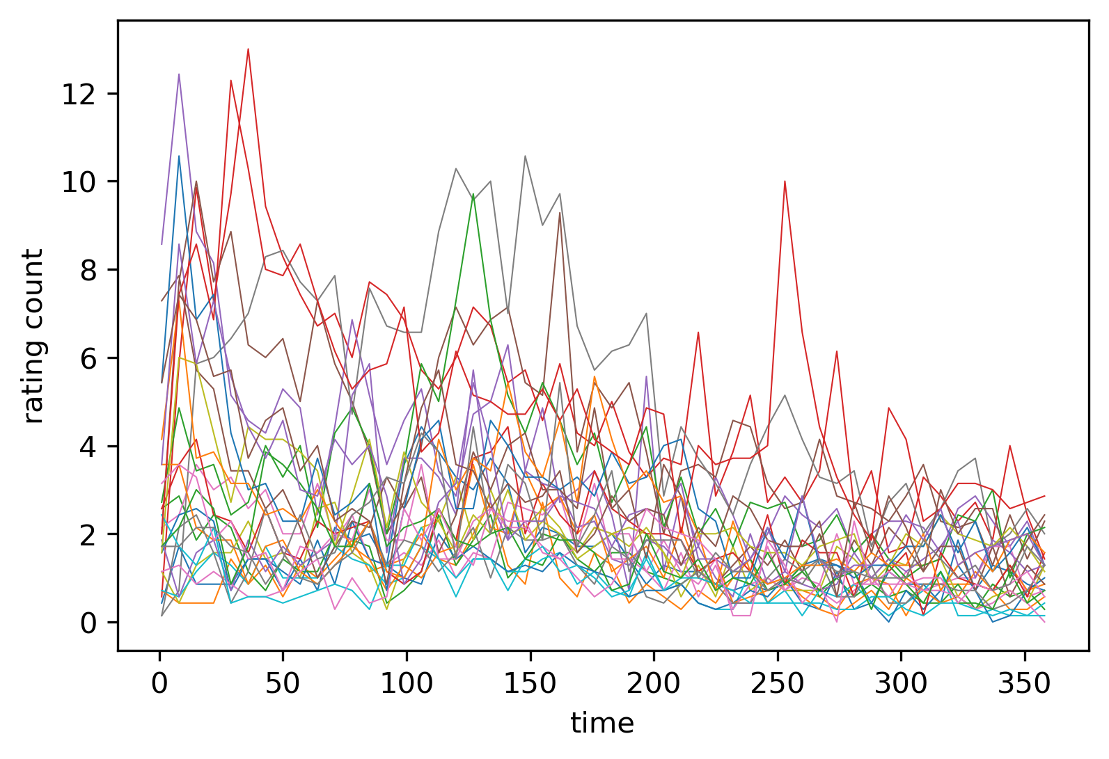
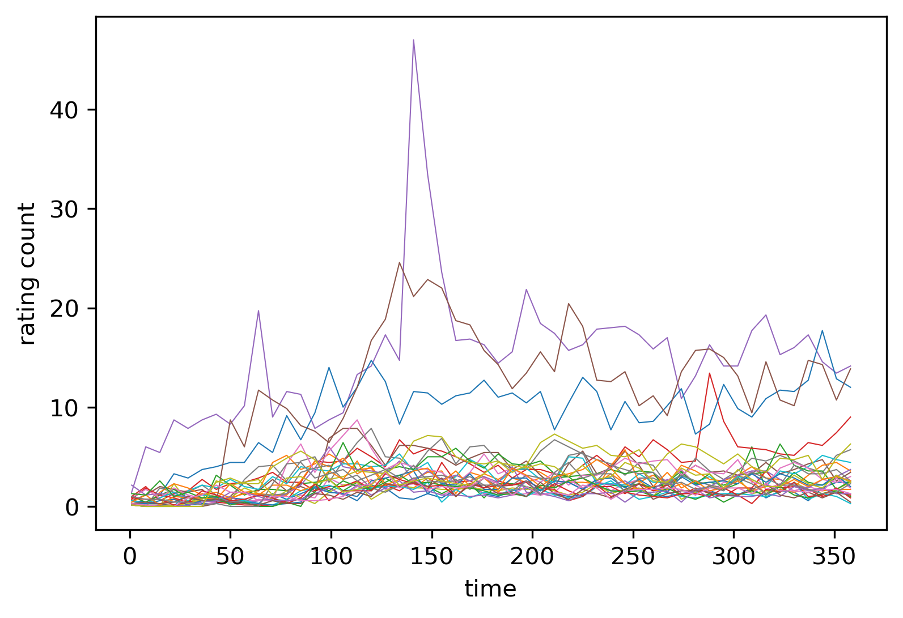
Experiment: Clustering
Selected min cluster size: 6
There are some temporal patterns inside the clusters
However, vast majority of the movies are clustered into one of the clusters
Very few movies are clearly clustered (104 movies in this setup)

Slide 23
Conclusion and Future Work

Slide 24
Conclusion and Future Work
Conclusion:
Implemented an evaluation method that follows the global timeline
Proposed a time-series-based algorithm, and proved its effectiveness
Explored the temporal characteristics of time series data
Future work:
Addition on time-series-based algorithm design
Adopt the evaluation method that follows the global timeline for other recommender systems
Customization on Clustering algorithm

Slide 25
Thank you for your time!

